Slide 1


Numerical Integration USING <Python/>

Slide 2
Numerical Integration Methods:
Mid Point Rule
Trapezoid Rule
Simpson (1/3) rule
Simpson (3/8) rule

Slide 3

Our Team Members
M. Wajahat Tariq (22F-BSAI-17)
Hamza Kamelen (22F-BSAI-09)
Moiz Mansoori (22F-BSAI-32)
M. Sami (22F-BSAI-43)
Muzzammil Khalid (22F-BSAI-29)
Rayyan Ahmed (22F-BSAI-11)

Slide 4


Numerical integration
When ordinary arithmetic is insufficient to calculate the whole area under a curve, numerical integration is used. Consider stacking up several little pieces to obtain a whole image. It's quite useful when working with complicated shapes or data. Assume you're attempting to measure the volume of water in an unusually shaped pond; numerical integration can assist you acquire an accurate estimate. It's like taking a creative shortcut to overcome complex issues!

Slide 5

Midpoint method
The midpoint method is a simple and effective way to estimate the area under a curve. Instead of using the endpoints, it takes the average value of the function at the middle of each interval. Imagine slicing a curve into equal parts and finding the height at the center of each slice. By adding up these middle heights, you get a good estimate of the total area. It’s a neat trick to get more accurate results with less effort!

Slide 6
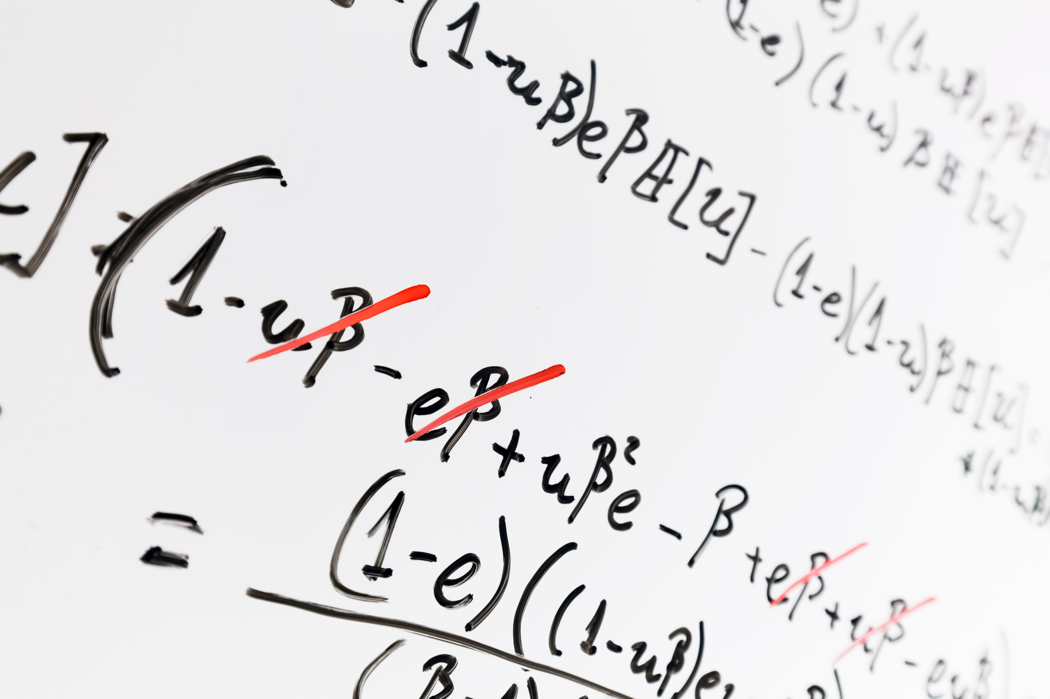

FORMULA
$\int_{a}^{b}{f\left(x\right)ⅆx}≈Σ_{ⅈ=0}^{n−1}$ $f(\frac{xi​+xi+1}{2}$​​) $Δx$

Slide 7
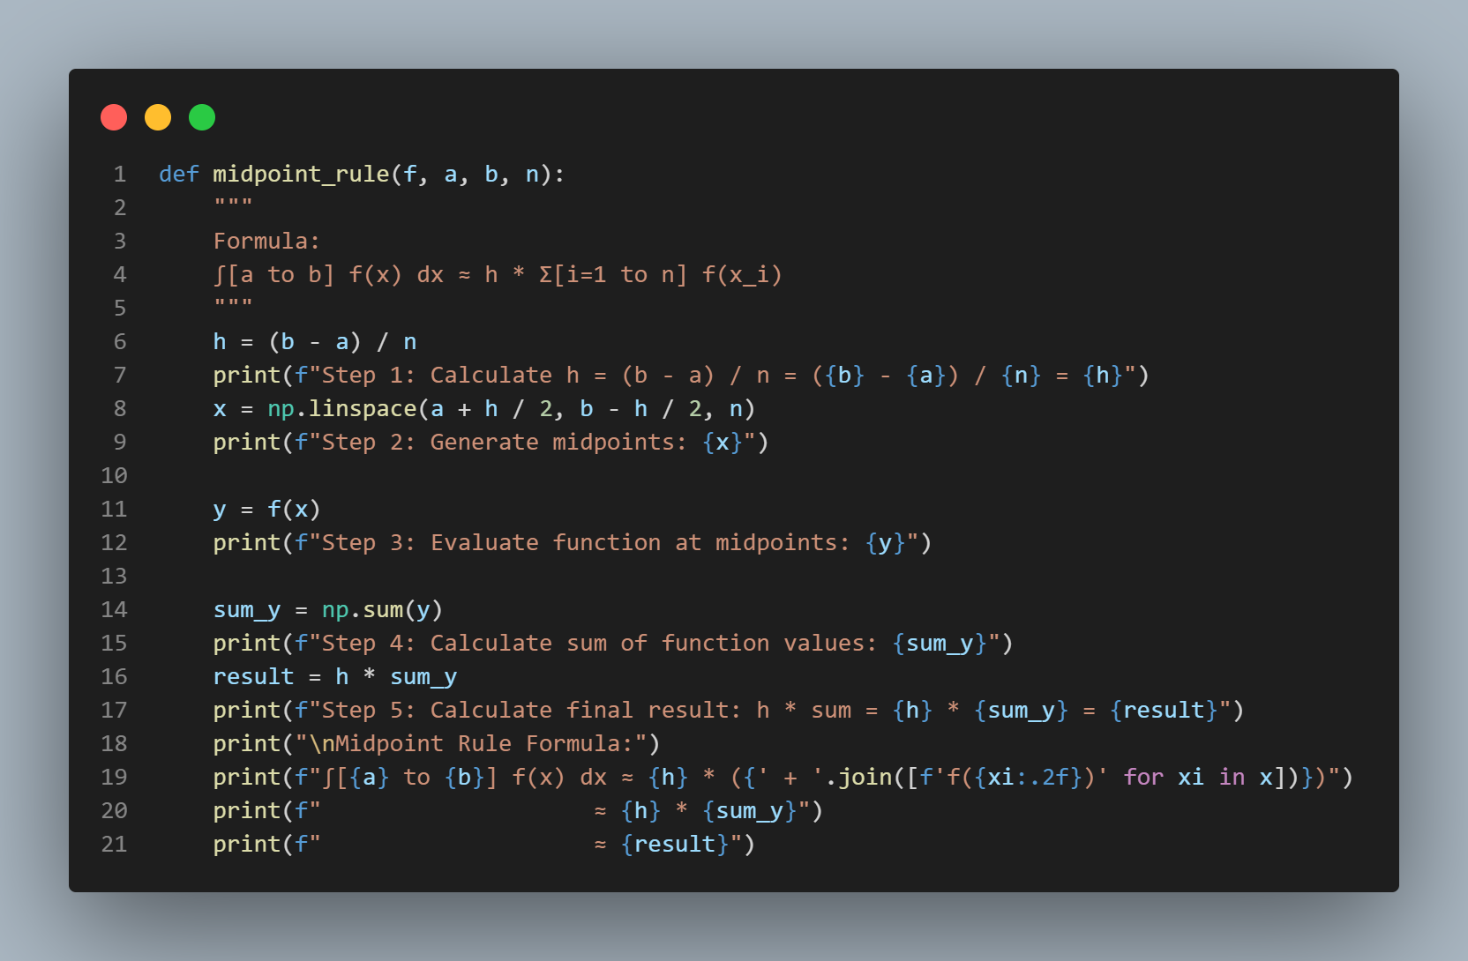

Slide 8
Trapezoidal Rule
The trapezoid method, also known as the trapezoidal rule, is a technique in numerical integration used to approximate the definite integral of a function. The basic idea is to divide the area under the curve into trapezoids rather than rectangles, which can provide a more accurate approximation, especially when the function is not constant.

Slide 9


FORMULA
$$\int_{a}^{b}{f\left(x\right)dx ≈ \frac{∆x}{2} [ f \left(x_{0}\right)+2\sum_{i=1}^{n−1​}{f(x_{i} )+f(x_{n})]}}$$

Slide 10
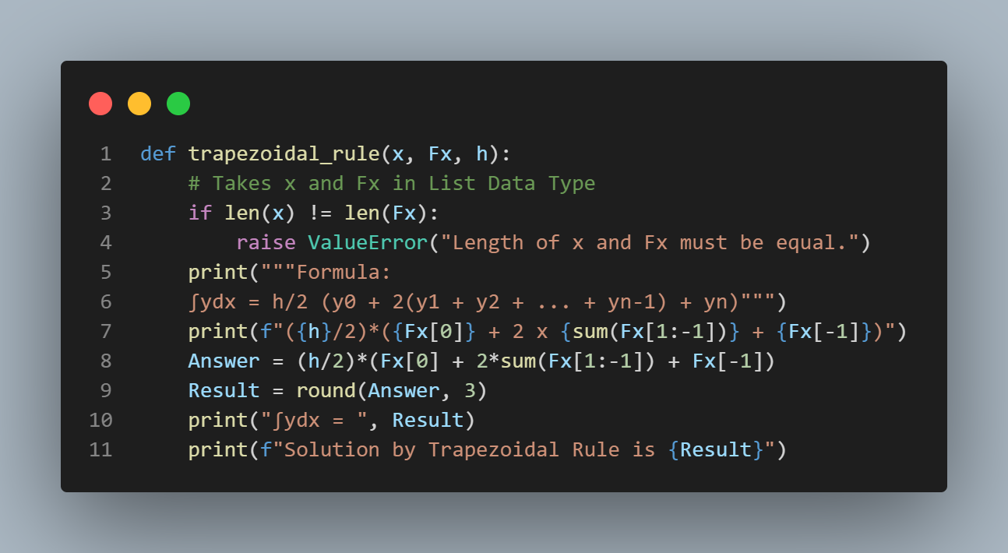

Slide 11

Simpson (1/3) Rule
Simpson (1/3) rule is a powerful technique to estimate the area under a curve. It combines parabolas to approximate the shape of the curve, making it more accurate than simpler methods. Imagine fitting smooth curves over small sections of your data to get a better total area estimate. It's particularly useful for functions that are difficult to integrate directly, providing a precise and reliable approximation.

Slide 12


FORMULA
$$\int_{a}^{b}{f\left(x\right)dx≈ \frac{∆x}{3}}[ f\left(x_{0}\right)+4\sum_{odd i}{f\left(x_{i}\right)+2\sum_{even i}{f\left(x_{i}\right)+fx_{n})]}}$$

Slide 13
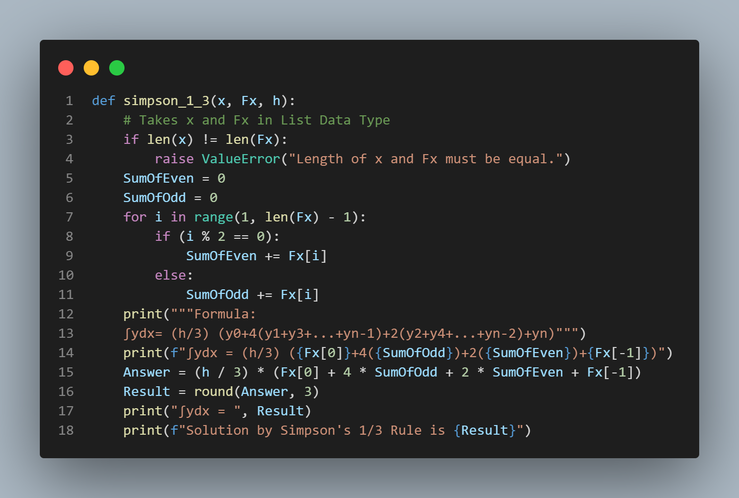

Slide 14

Simpson (3/8) Rule
Simpson 3/8 rule is another technique to estimate the area under a curve, similar to Simpson 1/3 rule but using cubic polynomials. It fits a third-degree polynomial over every three subintervals, making it highly accurate for smooth functions. Imagine drawing smooth curves that closely follow the data points, giving you a precise total area estimate. This method is especially useful when the number of subintervals is a multiple of three.

Slide 15


FORMULA
$$\int_{a}^{b}{f\left(x\right)dx ≈ \frac{2∆x}{8} [ f \left(x_{0}\right)+3\sum_{i=1,2,mod 3=1,2​}{ f(x_{i})}}+2\sum_{i=3,6,9,…​}{f(x_{i} )+f(x_{n})]}$$

Slide 16
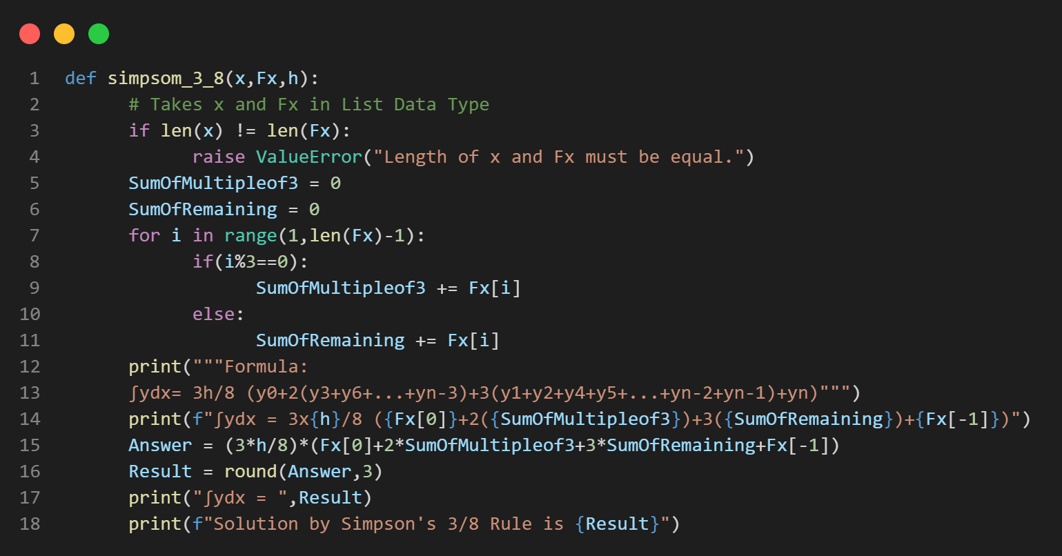

Slide 17

HOSTED LINK
https://numerical-integration-duet-project.streamlit.app/
SCAN QR CODE

Slide 18

Thank you!

